Slide 1
Communicating with Data – Visualization Fundamentals Pt. 2
Dr. Ab Mosca (they/them)
Slides based off slides courtesy of Jordan Crouser (https://jcrouser.github.io/)

Slide 2
Plan for Today
Refresher: building blocks and mental models
Putting marks together
Group activity: what we draw vs. what we see
Discussion

Slide 3
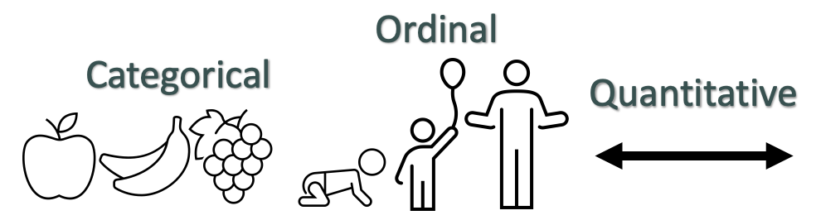
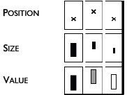

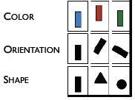
Data → Visuals
Remember… Big idea behind visualization
Map data dimensions to visual dimensions in a principled way
Not all visual dimensions can represent all data types
Jacques Bertin, Semiologie Graphique
(Semiology of Graphics), 1967.

Slide 4
Marks and Channels Activity Recap
Finish up and get ready to share with the class.
Work with 2 other people. Be prepared to share your work with the class.
Find a data visualization you think is interesting
Some ideas: New sites, government sites, Tableau, massvis.mit.edu
Write down what you chose on the board so we don’t get repeats!
Identify the following:
What is the data that’s being visualized?
Where did the data come from?
What marks and channels are used in the visualization?
What data dimensions do the marks and channels represent?
What do you learn from looking at the visualization?
What additional questions do you have?

Slide 5
Marks and Channels Activity Recap
Takeaways? Notice any themes? Any recurring problems? Any visualizations you particularly liked?

Slide 6
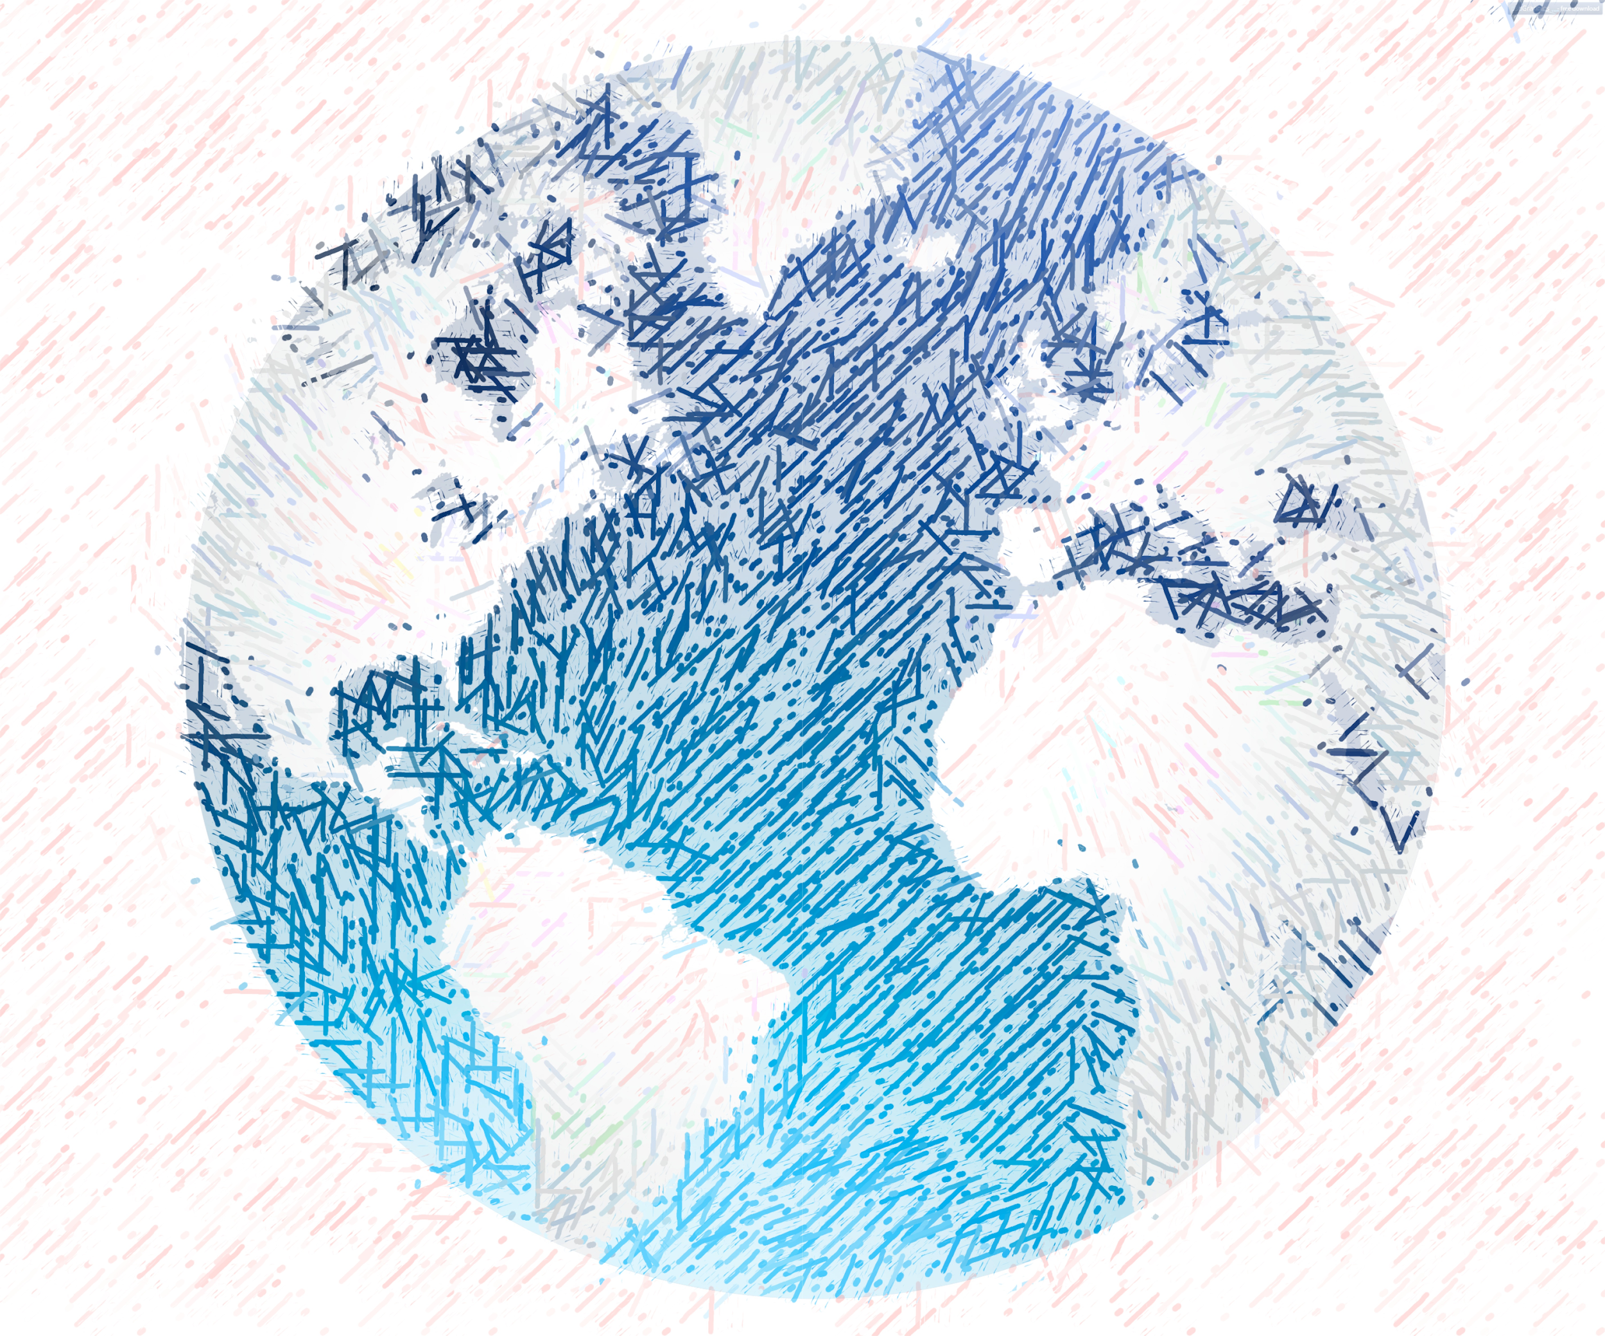


Mental Models

Slide 7
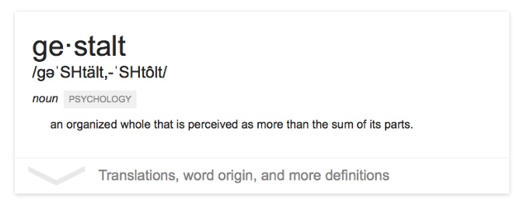
The “gestalt effect”
Our brain’s ability to generate whole forms, instead of just collections of unrelated elements

Slide 8

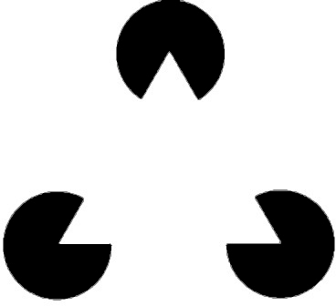
1. Reification
Gestalt Principles
Demonstration of reification in perception from Lehar S. (2003) The World In Your Head, Lawrence Erlbaum, Mahwah, NJ. p. 52, Fig. 3.3

Slide 9
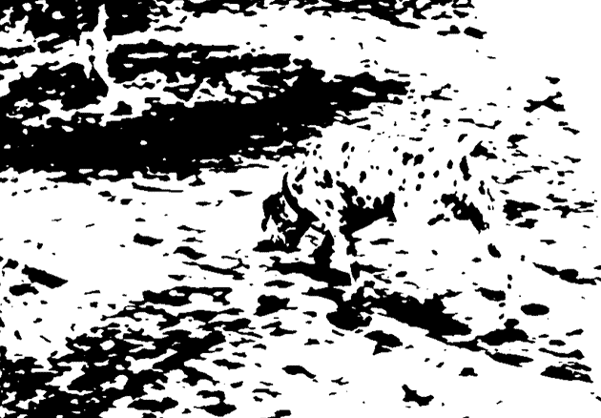
2. Emergence
Gestalt Principles
Life Magazine: 58;7 1965-02-19, p 120. Photographer: Ronald C James

Slide 10
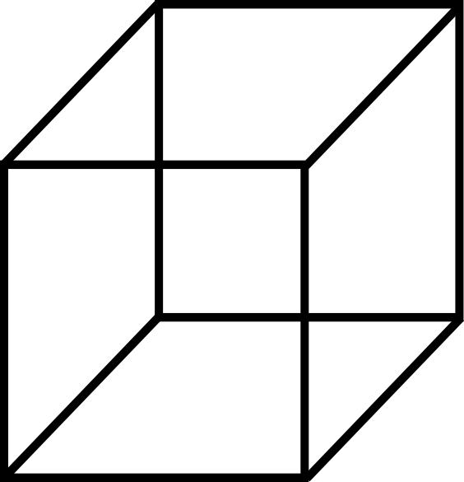
3. Multistability
Gestalt Principles

Slide 11
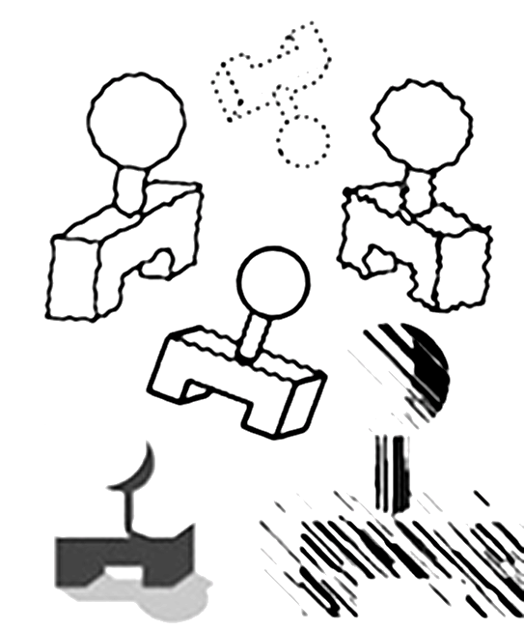
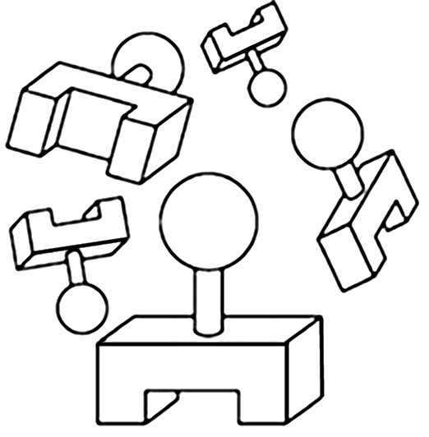
4. Invariance
Gestalt Principles
Demonstration of invariance in perception from Lehar S. (2003) The World In Your Head, Lawrence Erlbaum, Mahwah, NJ. p. 53, Fig. 3.5

Slide 12
What does this mean for visualization?
Question: what makes all this mental model stuff useful to us (designers and readers of data)?
Answer: in order to understand how people interpret and make sense of data, we need to know what cues they’re picking up on – and how to situate those cues within a larger framework
6 “Laws of Grouping”

Slide 13
We interpret objects that are close to each other as a group
Law of Proximity

Slide 14
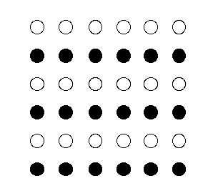
We interpret objects that are visually similar to each other as a group
Law of Similarity
“white dots”
“black dots”

Slide 15

When parts of a picture are missing, we fill in the visual gap
Law of Closure

Slide 16
Law of Symmetry
We perceive objects as being symmetrical, arranged around a center point
law of proximity
[ ] { } [ ]
law of symmetry + law of similarity

Slide 17
We group objects that we perceive to be moving along the same path
Law of Common Fate

Slide 18
We tend to group objects along the smoothest path
Law of Continuity

Slide 19
Break into teams of 3
Choose a visualization from the Tableau Vis of the Day collection: https://public.tableau.com/app/discover/viz-of-the-day
Write the title on the board so we don’t get repeats!
Goal: identify as many examples of the Laws of Grouping (Gestalt Principles) in action in your sample visualization as you can
Be prepared to present your findings to the class
Let’s Practice

Slide 20
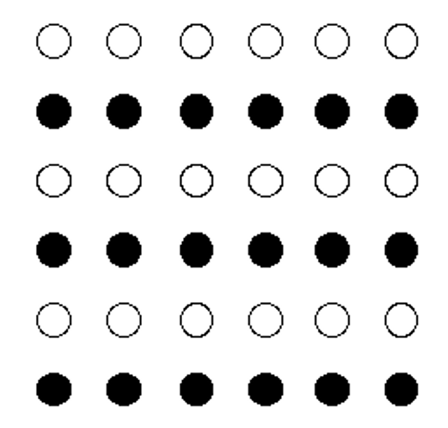

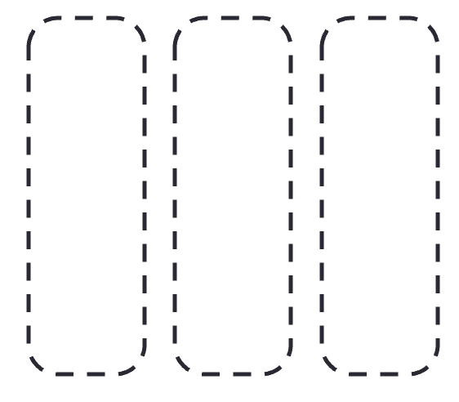
Group activity: what we draw vs. what we see
Let’s Practice
proximity
similarity
closure
[ ]
symmetry
common fate
continuity

Slide 21

Reminder
Our labs will be run using Tableau, a drag-and-drop visualization tool suite
Tableau for Teaching has donated license keys (good for one year) for everyone enrolled in this course
Instructions for getting a license have been posted; please install before next class!
Need help? Ping me, or come to office hours

